Slide 1
Course 6 Gender, School and Society
Unit I - Gender roles in society
M.Amala Jansi
Assistant Professor
Pedagogy of Computer Science
Loyola College of Education
Chennai-34.
Mob. No. 8778220620
Email-amalajansi78@gmail.com

Slide 2
Gender: Meaning and definition
Difference between gender and sex
Gender roles in society: family, caste, class, religion, culture, the media and popular culture, law and the state (film, advertisements, songs, etc)
Overview
Reasons for gender inequalities
Gender-just education outside school settings

Slide 3
Objectives
The learner will be able to…
Defines Sex and Gender
Differentiates Sex and Gender
Identifies gender roles in society
List outs the reasons for gender inequalities
Explains gender-just education outside school settings

Slide 4
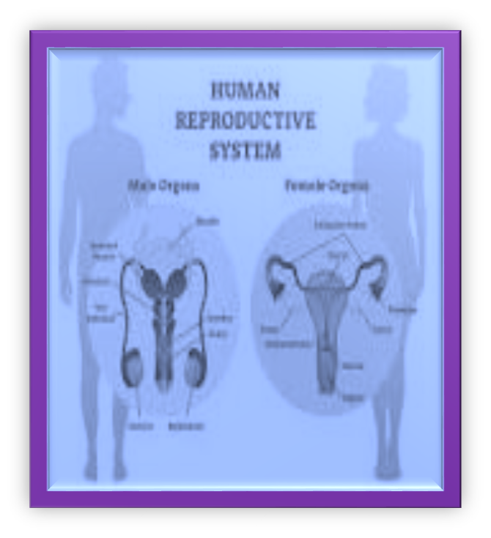
Sex
Sex describes the biological differences between men and women, which are universal and determined at birth.
Example :
The differences in the organs related to reproduction.

Slide 5
Definition of “Sex”
Sex’ refers to the biological characteristics or natural biological differences between men and women, for example, the differences in the organs related to reproduction. A person’s sex is biologically determined as female or male according to certain identifiable physical features which are fixed. Women’s marginalization has often been seen as ‘natural’ and a fact of their biology.

Slide 6


Gender
Gender refers to the roles and responsibilities of men and women that are created in our families, our societies and our cultures.

Slide 7
Definition of “Gender”
Gender refers to the cultural, socially constructed differences between the two sexes. It refers to the way society encourages and teaches the two sexes to behave in different through socialization. ‘Gender’ and the hierarchical power relations between women and men based on this are socially constructed, and not derived directly from biology.

Slide 8

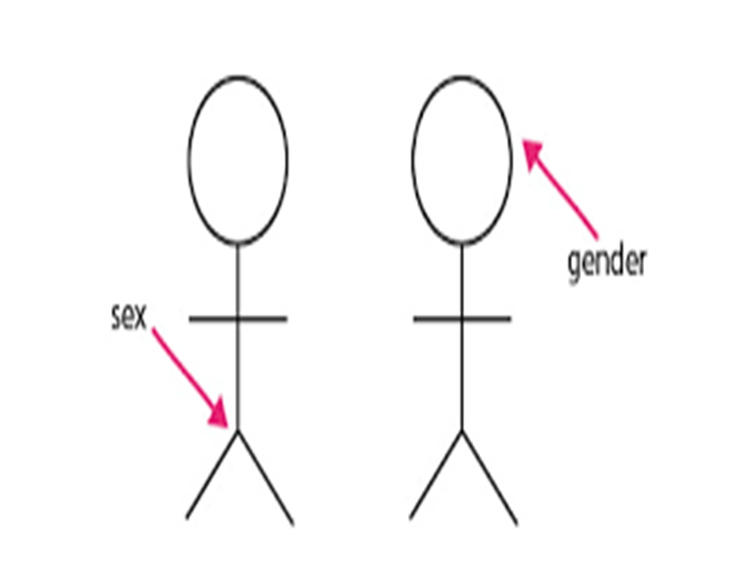
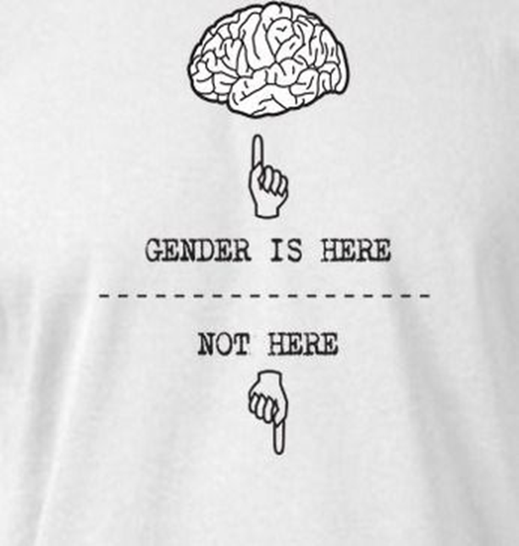

Slide 9
Sex | Gender
Sex refers to the biological differences between male and female. | Gender refers to socially and culturally constructed differences between male and female.
Sex of an individual is determined by nature. | Gender differences are due to nurture.
Sex is Constant, it remains the same everywhere. | Gender is Variable ; it changes from time to time, culture to culture , even family to family.

Slide 10
Sex
Gender
Sex cannot be changed without complex medical intervention. | Difficult, but not impossible to change.
Non-hierarchical. | Hierarchical.
“ Male “ and “ Female are sex categories. | “ Masculine” and “ Feminine” are gender categories.
Sex is created by the reproduction needs, that is, biological features. | Gender distinctions are created by social norms.
Equally valued. | Unequally valued. (masculinity as the norms)
Fixed at birth. | Learned through socialization.
The individual’s external and internal organs, hormonal and chromosomes determine the person’s sex. | Gender is defined by the personality traits, attitudes, behaviours, values that society ascribes to male and female.

Slide 11


Gender Stereotypes
Stereotype is a fixed, general image of a person or thing shared by many people.
Gender role stereotyping occurs when a person is expected to enact a series of norms or behaviors based upon their sex.
Gender stereotypes are simplistic generalizations about the gender attributes, differences, and roles of individuals or groups. Stereotypes can be positive or negative.
Traditionally, the female stereotypic role is to marry and have children.
The male stereotypic role is to be the financial provider.

Slide 12
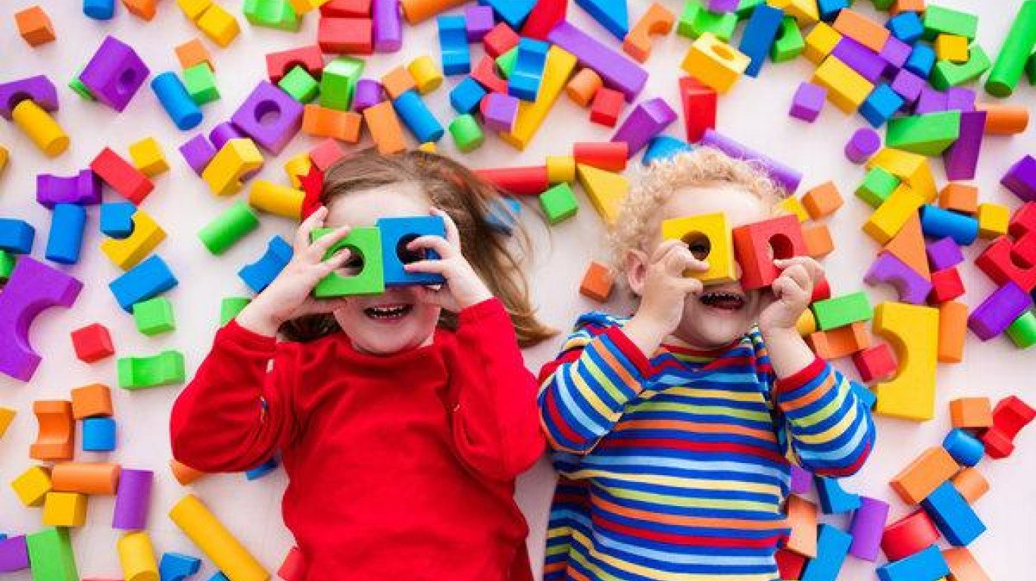
Gender roles in society
The behaviors of men and women that are considered socially appropriate are called gender roles.

Slide 13

Family
Gender roles are defined by the socio-cultural norms of any society.
In most of the societies the family systems are based on the gender roles.
Types of activities, including preference of toys, play styles, discipline, chores, and personal achievements.

Slide 14
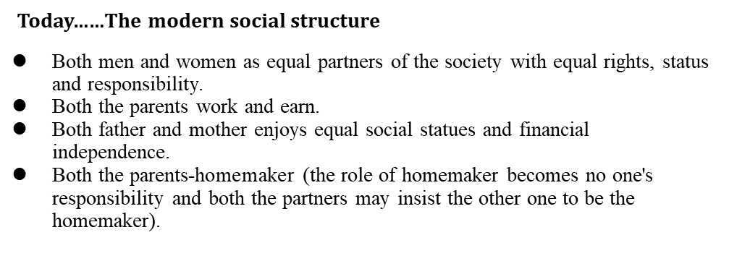
Today …..The modern Social Structure

Slide 15


Slide 16
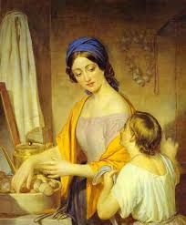
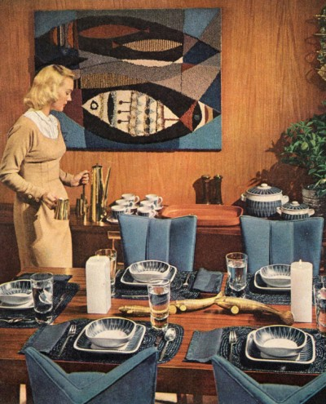

Gender Roles in Class
Lower
Middle
Upper

Slide 17
Religion
The main religions of the world all contain certain ideas about the appropriate roles for men and women in society, and traditionally, this has placed women in the home and men in the ‘outside’ world.
The cultural and religious activities that negatively impacted against the education of the girl child were most found.

Slide 18
Culture & Popular Culture
Culturally determined gender ideologies define rights and responsibilities and what is ‘appropriate’ behaviour for women and men.
Expectations about attributes and behaviours appropriate to women or men and about the relations between women and men – in other words, gender – are shaped by culture.
The term ‘popular culture’ was coined in the 19th century or earlier.
The abbreviated form “pop” for popular.
For example: Generally, super heroes are men. Women always expect to rescue.

Slide 19

Media
The main aim of mass media is to be universal and suitable for everyone, in order to gather the largest possible audience.
Mass media not only gives people information and entertainment, but it also affects people’s lives by shaping their opinions, attitudes and beliefs.
Portrayed-gender stereotypes.

Slide 20


Advertisement
Men generally advertise cars, cigarettes, business products or investments, whereas women are shown rather in the commercials with cosmetics and domestic products.

Slide 21
Films
The Bollywood films have well portrayed the changes happening in the society the films has always been criticized for its almost ignoring the issues of gender.

Slide 22
Law and State:
Law is pervasive and affects many aspects of people’s lives, women and men alike.
Inequalities in endowments, access to resources and rights, social (and household) status, voice and agency are perpetuated, codified, contested and redressed through norms and the institutions established or resulting from such norms, be they social or legal.

Slide 23

Gender Inequality
Gender inequality is the unequal treatment or perceptions of individuals based on their gender. It arise from differences in socially constructed gender roles.

Slide 24
Important causes of gender disparity
Poverty
Illiteracy
Lack of Employment Facilities
Social Customs , Beliefs and Practices
Social Altitude
Lack of Awareness of Women

Slide 25
Reasons for gender inequalities in India
Education
Religious belief
Weaker Sex
Lack of resources
Lack of awareness
Giving importance to male child
Dowry system
Other reasons : Due to diversity on many counts like differences in ideas , opinion , language , colour , region and caste.

Slide 26
HOW TO REDUCE INEQUALITY:
IN EDUCATION
Offering high level education
Social integration
Increasing women employment
Involving them in active politics and social activities
Arranging social protection programs
Generating awareness among parents
Giving scholarships to girls
Others
Policies, recommendations and initiatives for gender equality
Welfare Programmes and Policies for Women by Government
Policies of the Government

Slide 27
Gender-just education outside school settings
Agency of Education:
Formal: This includes institutions deliberately set up by the society with specific objective of carrying out the various functions of education. Ex: the school
Informal: This includes institutions which perform educational functions just incidentally and indirectly. Ex: Family , peer group, youth clubs…
Non-formal Education (NFE) is any organized educational activity that takes place outside the formal educational system. Usually it is flexible, learner-centered, contextualized and uses a participatory approach. There is no specific target group for NFE; it could be kids, youth or adults. Ex:NGOs.

Slide 28
Questions for Discussion and Reflection
Differentiate gender and sex.
Explain the various gender roles in society.
Discuss the reasons for gender inequalities and effective ways to remove inequality.
What is the status of gender equality in present India?

Slide 29

Future Reading…..
Lippa , Richard A. 2002. Gender, Nature, and Nurture. Mahwah, NJ: L. Erlbaum.
Oakley, Ann. 1972. Sex, Gender, and Society. New York: Harper and Row.
Thorne, Barrie. 1993. Gender Play: Girls and Boys in School. New Brunswick, NJ: Rutgers
University Press.
Website:
http://www.ekvilib.org/wp-content/uploads/2017/06/01_Gender_Concepts.pdf
https://digitalcommons.library.umaine.edu/cgi/viewcontent.cgi?article=1000&context=soc_facpub

